Slide 1
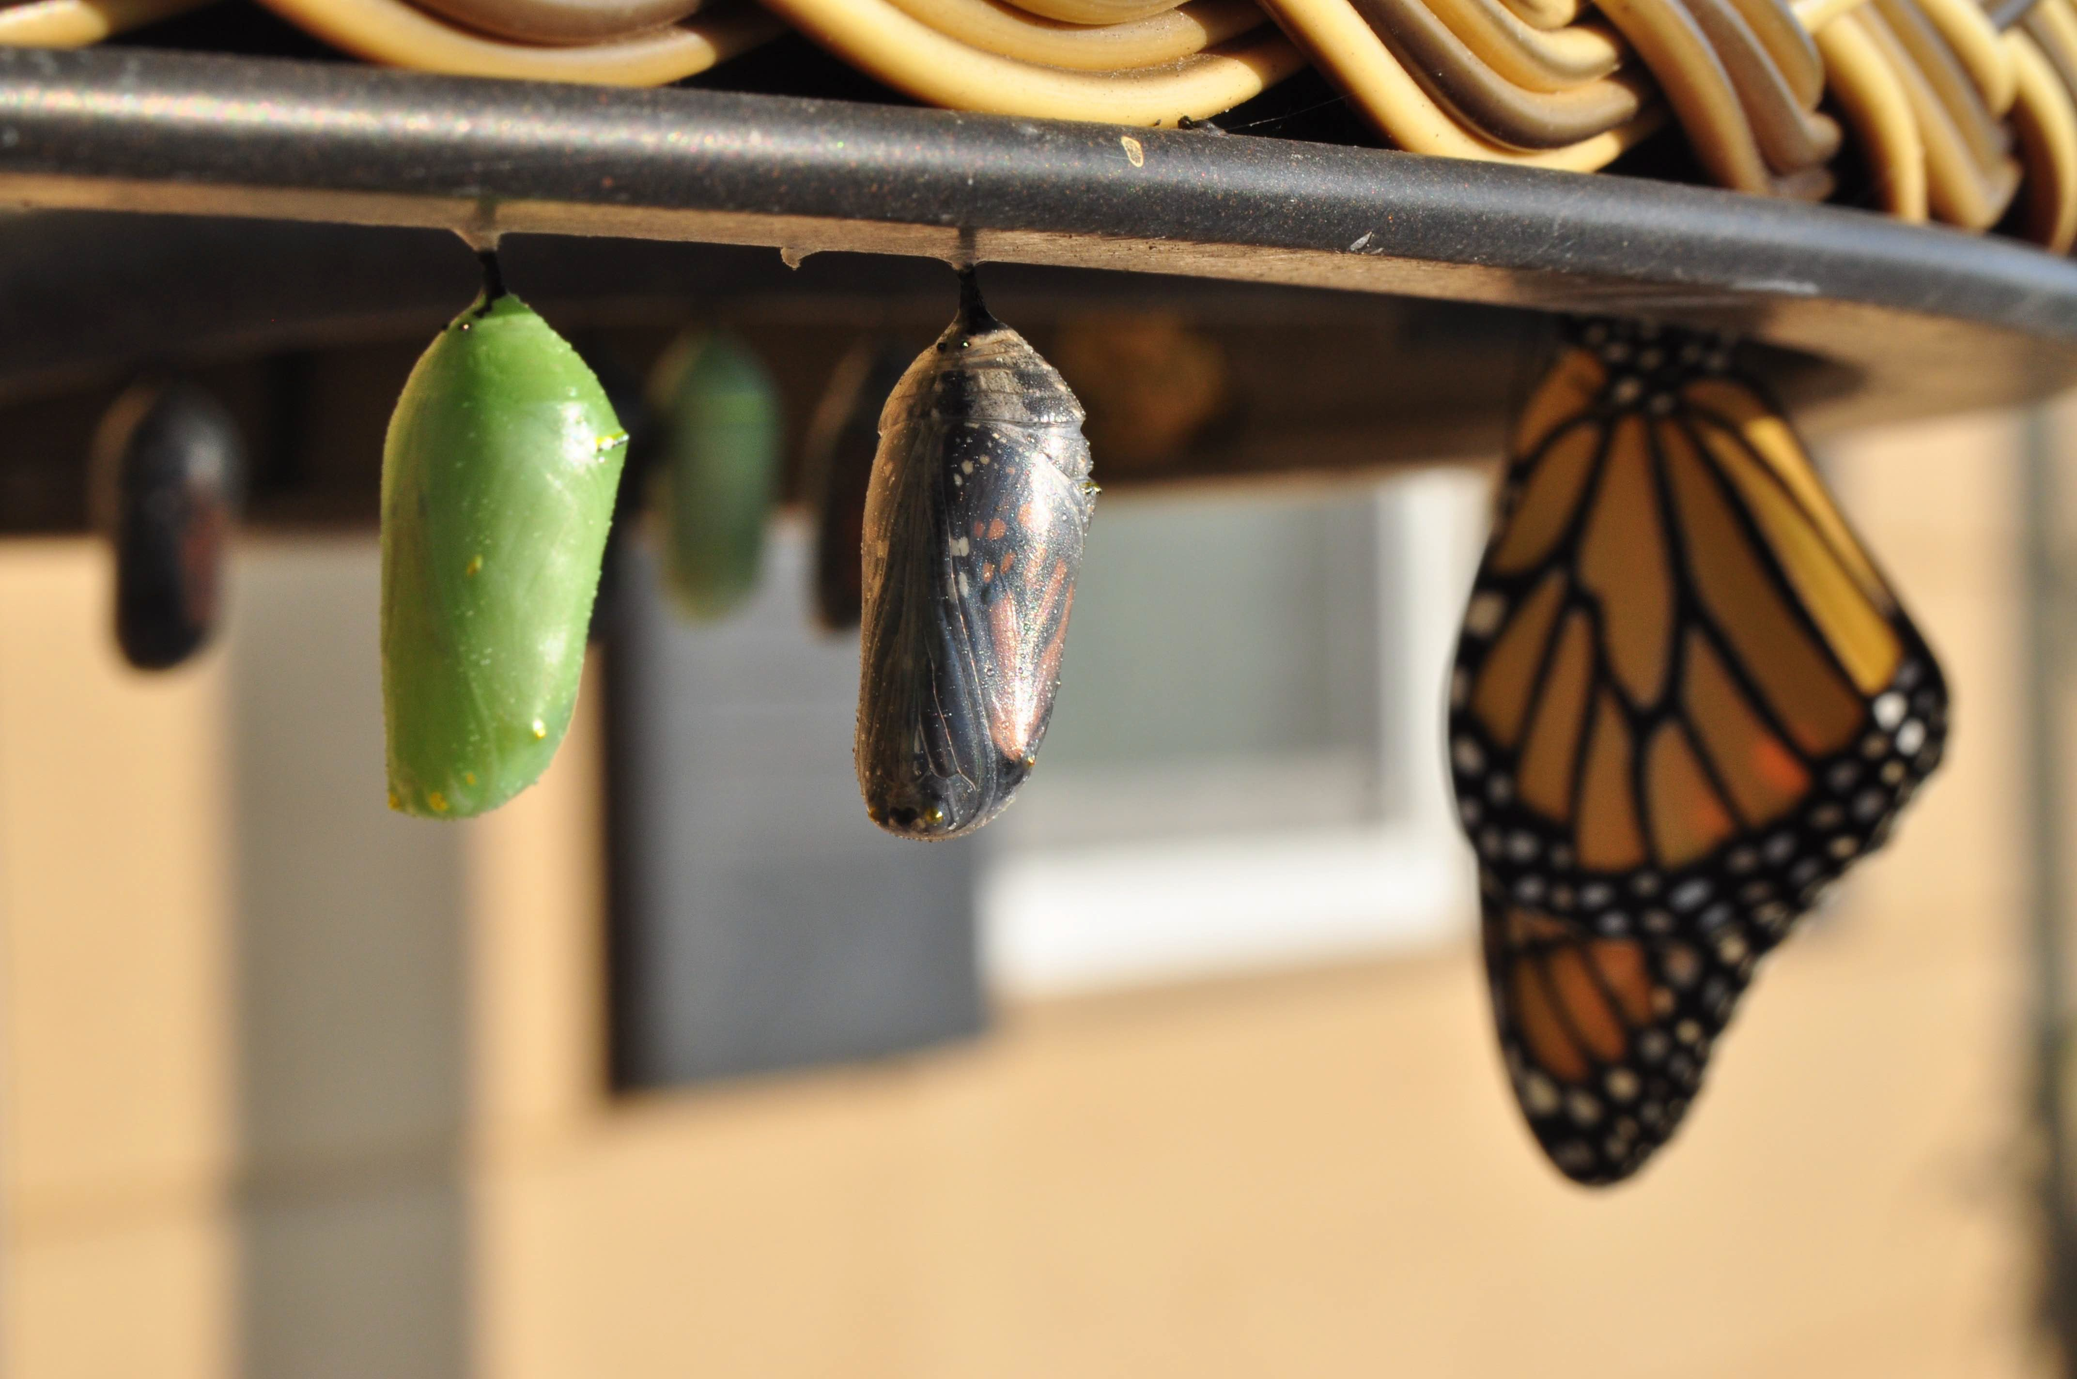
Introduction to Modern Controls
State-Space Introduction
State-Space Introduction

Slide 2
Why state space?
static/memoryless system: present output depends only on its present input: y(k) = f(u(k))
dynamic system: present output depends on past and its present input,
▶ e.g., y(k) = f(u(k), u(k − 1), . . . , u(k − n), . . . )
▶ described by differential or difference equations, or have time delays
how much information from the past is needed?
State-Space Introduction

Slide 3
The concept of states of a dynamic system
the state x(t) is the information you need at time t that together with future values of the input, will let you compute future values of the output y
loosely speaking:
▶ the “aggregated effect of past inputs”
▶ the necessary “memory” that the dynamic system keeps at each time instance
State-Space Introduction

Slide 4
Example
position: y(t)
k
u = F
b
m
to predict the future motion, we need to know
▶ current position and velocity
▶ future force
⇒ states: position and velocity
State-Space Introduction

Slide 5
The order of a dynamic system
position: y(t)
k
u = F
b
m
the number, n of state variables that is necessary and suﬀicient to uniquely describe the system
for a given dynamic system,
▶ the choice of state variables is not unique
▶ however, its order n is fixed
▶ i.e. you need not more than n but not less than n state variables
State-Space Introduction

Slide 6
States of a discrete-time system
consider a discrete-time dynamic system:
u (k)
System
_{y(k)}
x₁,x₂,...,xn
the state at any instance k_{o} is the minimum set of variables,
x₁(k_{o}), x₂(k_{o}), ⋯, x_{n}(k_{o})
that fully describe the system and its response for k ≥ k_{o} to any given set of inputs
loosely speaking, x₁(k_{o}), x₂(k_{o}), ⋯, x_{n}(k_{o}) defines the system’s memory
State-Space Introduction

Slide 7

Discrete-time state-space description
u (k)
System
_{y(k)}
x₁,x₂,...,xn
general case
linear time-invariant (LTI) case
x(k + 1) = f(x(k), u(k), k)
y(k) = h(x(k), u(k), k)
x(k + 1) = Ax(k) + Bu(k)
y(k) = Cx(k) + Du(k)
Σ(A, B, C, D) denotes a
u(k): input; y(k): output
x(k): state
x(k + 1) = f(·): state Eq
y(k) = h(·): output Eq
state-space realization
also written as $Σ=\left[\begin{matrix}A & B \\ C & D\end{matrix}\right]$
State-Space Introduction

Slide 8
Continuous-time state-space description
u (t)
System
_{y(t)}
x₁,x₂,...,xn
general case
LTI case
dx(t)
= f(x(t), u(t), t)
dx(t)
= Ax(t) + Bu(t)
dt
y(t) = h(x(t), u(t), t)
dt
y(t) = Cx(t) + Du(t)
State-Space Introduction

Slide 9

Example: mass-spring-damper
position: y(t)
k
u = F
b
m
$$x\left(t\right)=\left[\begin{matrix}\overset{\text{mass} \text{position}}{\overbrace{y\left(t\right)}} \\ \underset{\begin{aligned} \\ \text{mass} \text{velocity}\end{aligned}}{\underbrace{v\left(t\right)}}\end{matrix}\right]∈ℝ^{2}$$
State-Space Introduction

Slide 10
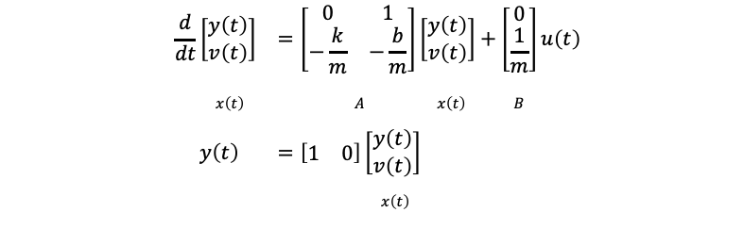
Example: mass-spring-damper
position: y(t)
k
u = F
b
m
$$\begin{matrix}\frac{d}{dt}\left[\begin{matrix}y\left(t\right) \\ v\left(t\right)\end{matrix}\right] & =\left[\begin{matrix}0 & 1 \\ −\frac{k}{m} & −\frac{b}{m}\end{matrix}\right]\left[\begin{matrix}y\left(t\right) \\ v\left(t\right)\end{matrix}\right]+\left[\begin{matrix}0 \\ \frac{1}{m}\end{matrix}\right]u\left(t\right) \\ & \end{matrix}$$
$$x\left(t\right) A x\left(t\right) B$$
$$y\left(t\right) =\left[\begin{matrix}1 & 0\end{matrix}\right]\left[\begin{matrix}y\left(t\right) \\ v\left(t\right)\end{matrix}\right]$$
$$x\left(t\right)$$
State-Space Introduction

Slide 11
Coding a continuous-time state-space system in MATLAB
A = [0,1;-3,-2];
B = [0;1];
C = [2,1];
D = 0;
sys_ss = ss(A,B,C,D)
[yout, T] = step(sys_ss); figure, plot(T, yout)
State-Space Introduction

Slide 12
Coding a continuous-time state-space system in Python
import control as co
import matplotlib.pyplot as plt import numpy as np
A = np.array([[0,1],[-3,-2]])
B = np.array([[0],[1]])
C = np.array([2,1])
D = np.array([0])
sys_ss = co.ss(A,B,C,D) print(sys_ss)
T,yout = co.step_response(sys_ss)
plt.figure(1,figsize = (6,4)) plt.plot(T,yout) plt.grid(True) plt.ylabel("y")
plt.xlabel("Time (sec)") plt.show()
State-Space Introduction

